Slide 1
Design Inspiration workshop
Here is where your presentation begins

Slide 2
Contents of this template
You can delete this slide when you’re done editing the presentation
Fonts | To view this template correctly in PowerPoint, download and install the fonts we used
Used and alternative resources | An assortment of graphic resources that are suitable for use in this presentation
Thanks slide | You must keep it so that proper credits for our design are given
Colors | All the colors used in this presentation
Icons and infographic resources | These can be used in the template, and their size and color can be edited
Editable presentation theme | They are sorted by theme so you can use them in all kinds of presentations
For more info: Slidesgo | Blog | FAQs
You can visit our sister projects: Freepik | Flaticon | Storyset | Wepik | Vidfy

Slide 3
Table of contents
01
02
03
04
Theory lesson
Features of the topic
You can describe the topic of the section here
You can describe the topic of the section here
Tips
Practical exercise
You can describe the topic of the section here
You can describe the topic of the section here

Slide 4
01
Theory lesson
You can enter a subtitle here if you need it

Slide 5
Introduction
Mercury is the closest planet to the Sun and the smallest one in the entire Solar System. This planet’s name has nothing to do with the liquid metal, since Mercury was named after the Roman messenger god. Mercury’s surface is filled with craters
Mercury takes a little more than 58 days to complete its rotation, so try to imagine how long days must be there! Since the temperatures are so extreme, albeit not as extreme as on Venus, Mercury has been deemed to be non-habitable for humans

Slide 6
Concepts
Concept 1
Concept 2
Mercury is the closest planet to the Sun and the smallest one in the Solar System—it’s only a bit larger than the Moon
Venus has a beautiful name and is the second planet from the Sun. It’s hot and has a poisonous atmosphere

Slide 7
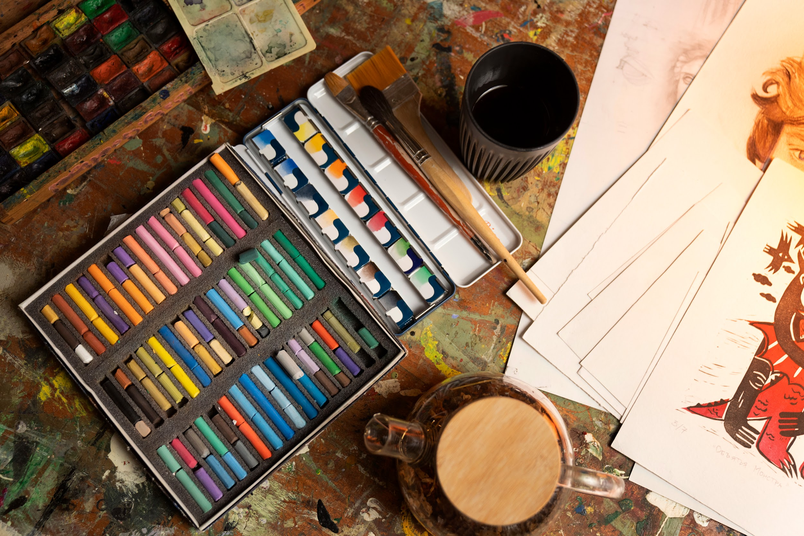
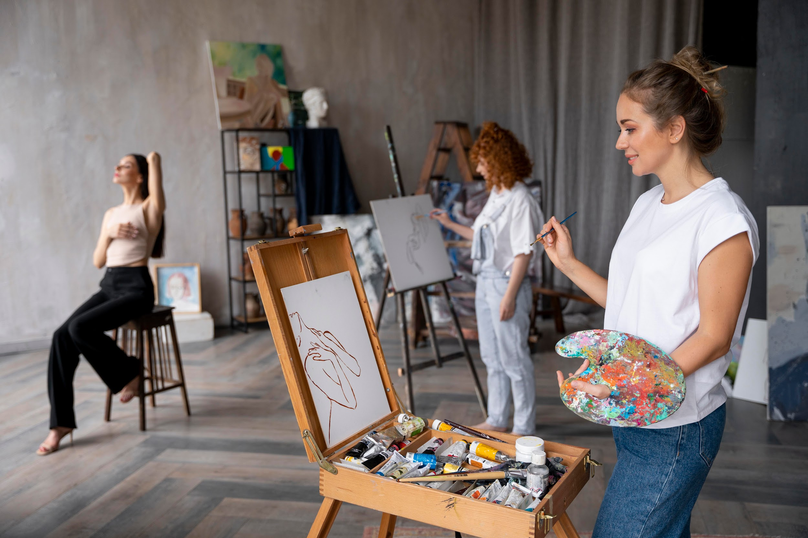
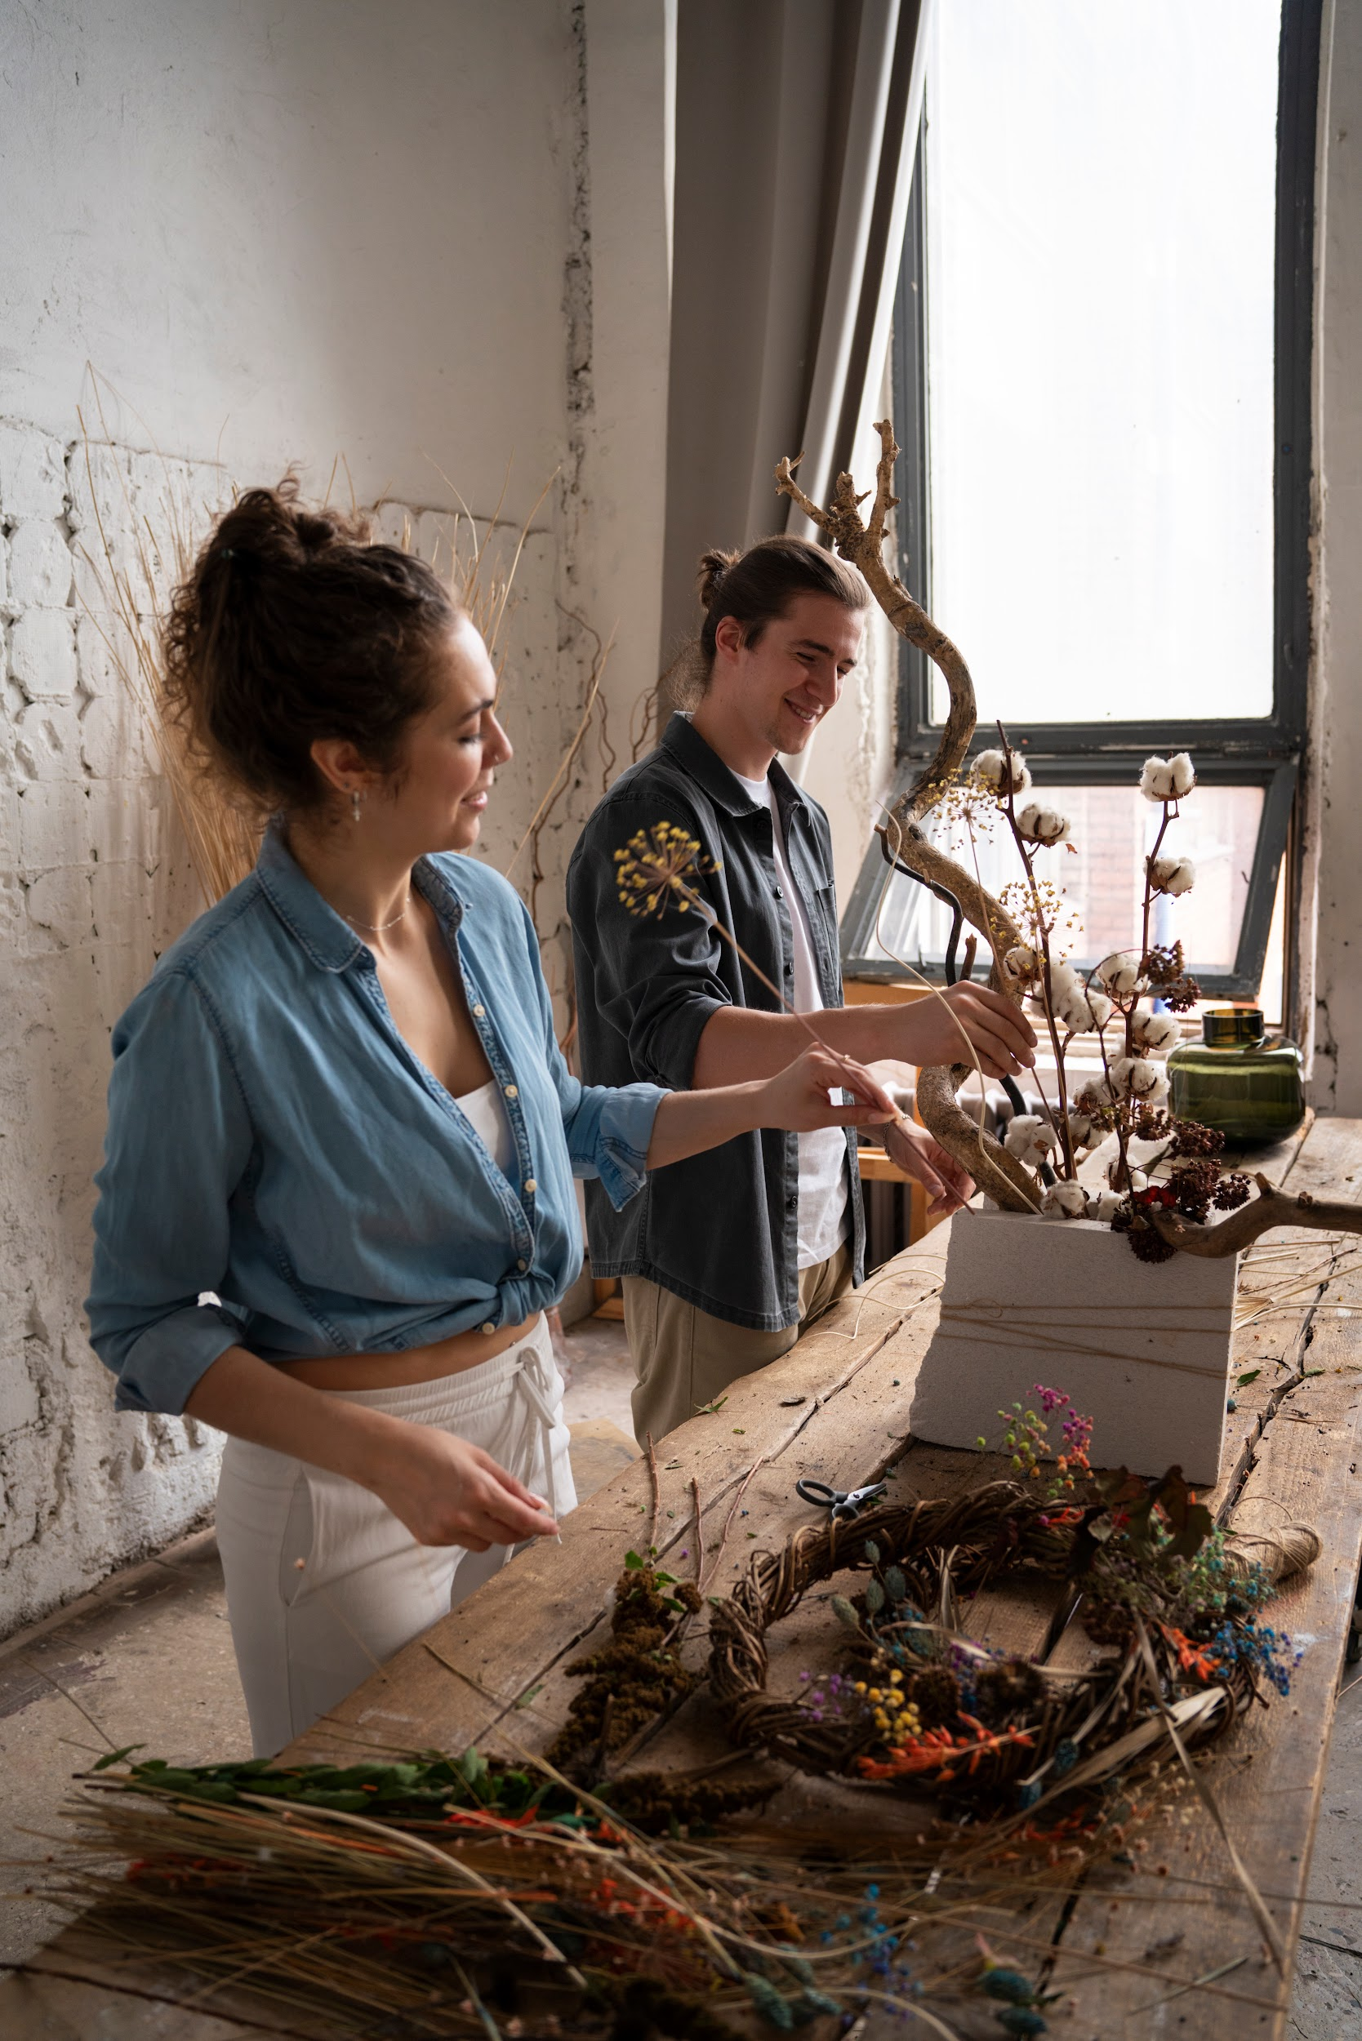
Examples
Mercury
Venus
Mars
Mercury is the closest planet to the Sun and the smallest one of them all
Venus has a beautiful name and is the second planet from the Sun
Despite being red, Mars is actually a cold place. It’s full of iron oxide dust

Slide 8
Recommendations
Mars
Venus
Neptune
Despite being red, Mars is very cold
Venus is the second planet from the Sun
Neptune is the farthest planet
Mercury
Saturn
Jupiter
Mercury is the closest planet to the Sun
Saturn is a gas giant and has several rings
Jupiter is the biggest planet of them all

Slide 9
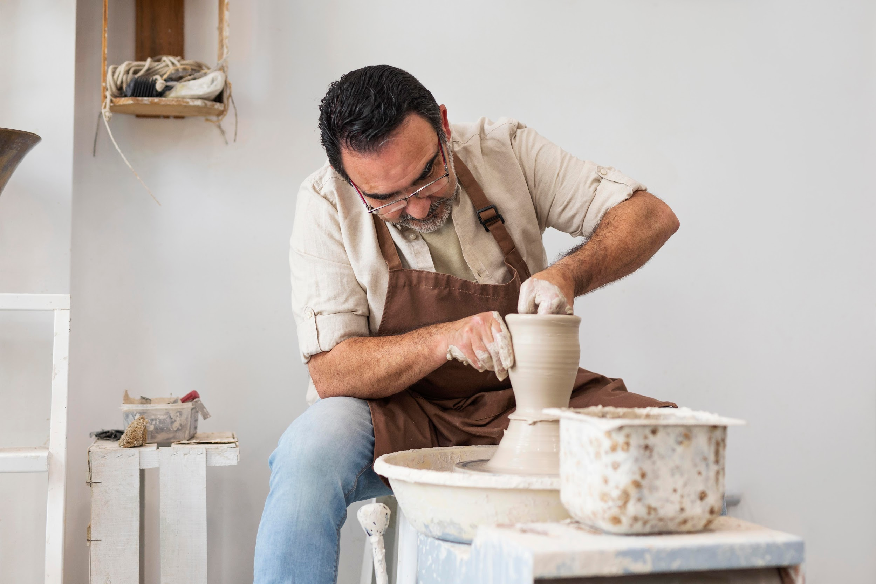
A picture always reinforces
the concept
You can give a brief description of the topic you want to talk about here. For example, if you want to talk about Mercury, you can say that it’s the smallest planet in the entire Solar System

Slide 10
Awesome words

Slide 11
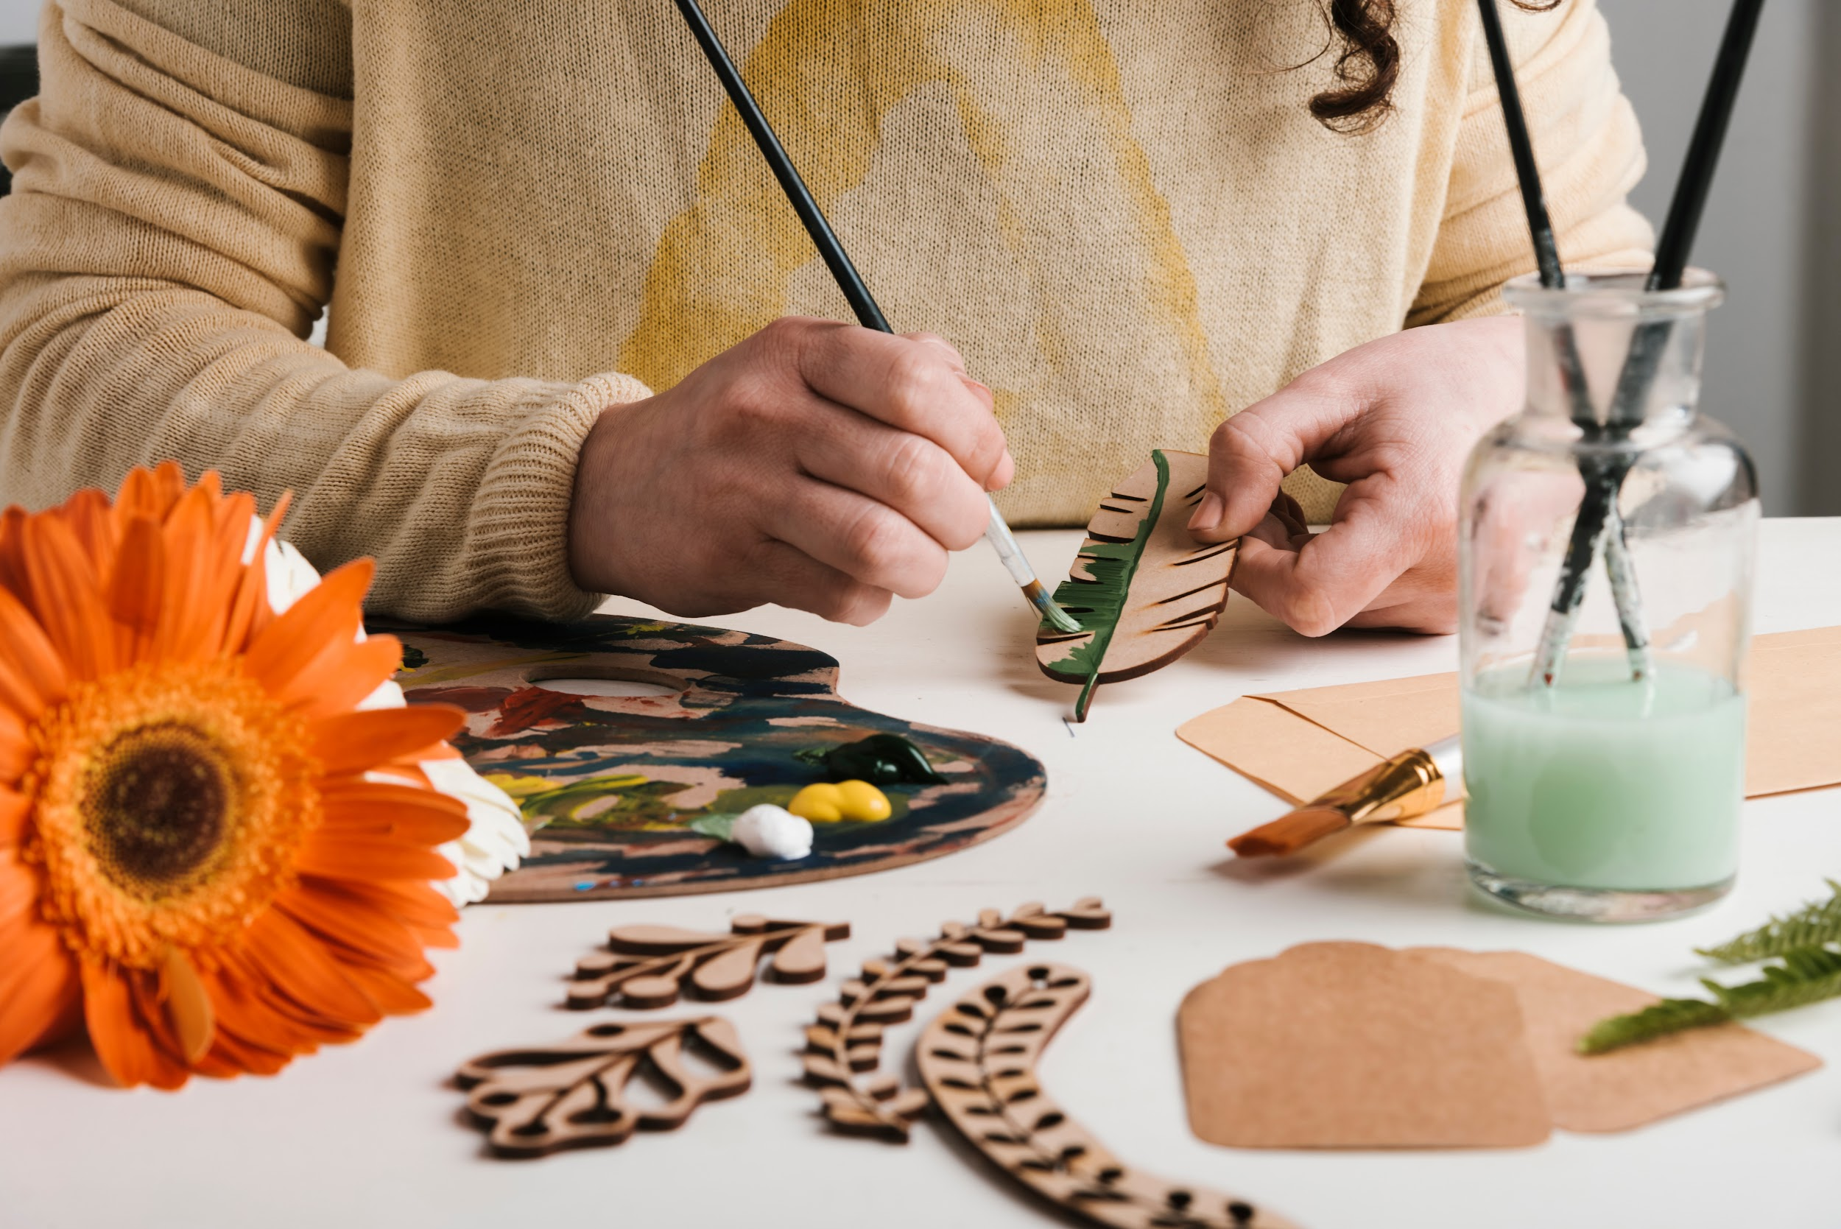
A picture is worth a thousand words

Slide 12
Line and contour exercise
Instructions: Use the Google Slides shapes and fill in the box with the different types of lines that the text indicates
Horizontal line
Vertical line
Curved line
Diagonal line
Wavy line
Extra: Repeat the freehand line type on a blank sheet of paper to improve your pulse

Slide 13
Brainstorm and idea generation
Power 1
Power 2
Power 2
Power 3
Power 3
Power 3
Power 3

Slide 14
Sequence
First
Next
Next
Mercury is the closest planet to the Sun
Venus is the second planet from the Sun
Despite being red, Mars is actually a cold place
Next
Next
Last
Jupiter is the biggest planet of them all
Saturn is composed of hydrogen and helium
Neptune is the farthest planet from the Sun

Slide 15
Classification
Mars | Venus | Mercury | Jupiter
Small Red Cold Rocky | Small Hot Dry Volcanic | Small Hot Rocky Cratered | Large Cold Gassy Striped
Despite being red, Mars is actually a cold place | Venus is hot, even hotter than Mercury | Mercury is the smallest planet of them all | Jupiter is the biggest planet of them all

Slide 16
Cause and effect
Environment
People
Measurement
Mercury is the closest planet to the Sun
Mars is actually a very cold place
Saturn is a gas giant and has several rings
Problem or goal
Venus is the second planet from the Sun
Jupiter is the biggest planet of them all
Neptune is the farthest planet from the Sun
Materials
Methods
Machines

Slide 17
Question and answer
Question
Is Mercury the closest planet to the Sun and the smallest one in the Solar System? Note that it’s a bit larger than the Moon
Answer
Venus has a beautiful name and is the second planet from the Sun. It’s hot and has a poisonous atmosphere

Slide 18
Timeline
Venus is the second planet from the Sun
Despite being red, Mars is a very cold place
Venus
Mars
Mercury
Jupiter
Mercury is the closest planet to the Sun
Jupiter is the biggest planet of them all

Slide 19
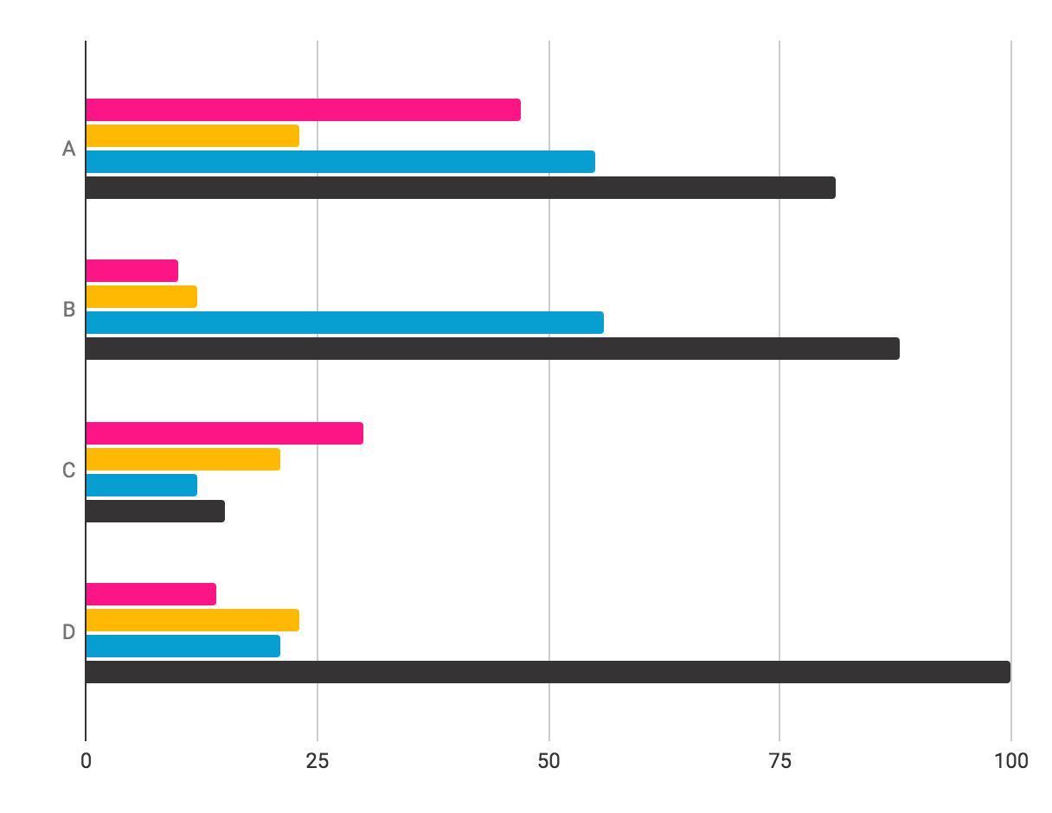
You can use this graph
Mercury
Venus
Mercury is a very small planet
Venus has very high temperatures
Jupiter
Saturn
Jupiter is a huge gas giant
Saturn is a gas giant with rings
Follow the link in the graph to modify its data and then paste the new one here. For more info, click here

Slide 20
Thanks!
Do you have any questions?
youremail@freepik.com
+34 654 321 432
yourwebsite.com
Please keep this slide for attribution

Slide 21
Alternative resources
Here’s an assortment of alternative resources whose style fits that of this template:
Vectors
Geometric colorful background
Flat design
Colored geometric shapes

Slide 22
Resources
Did you like the resources on this template? Get them for free at our other websites:
Photos
Shot women painting
Painting supplies on table
People building their own dried arrangement
Man doing pottery indoors medium shot
Wooden art pieces painting process
Vectors
World graphics day pack template
World graphics day banner template I
World graphics day banner template II
World graphics day banner template III
World graphics day banner template IV

Slide 23
Instructions for use
If you have a free account, in order to use this template, you must credit Slidesgo by keeping the Thanks slide. Please refer to the next slide to read the instructions for premium users.
As a Free user, you are allowed to:
Modify this template.
Use it for both personal and commercial projects.
You are not allowed to:
Sublicense, sell or rent any of Slidesgo Content (or a modified version of Slidesgo Content).
Distribute Slidesgo Content unless it has been expressly authorized by Slidesgo.
Include Slidesgo Content in an online or offline database or file.
Offer Slidesgo templates (or modified versions of Slidesgo templates) for download.
Acquire the copyright of Slidesgo Content.
For more information about editing slides, please read our FAQs or visit our blog:
https://slidesgo.com/faqs and https://slidesgo.com/slidesgo-school

Slide 24
Instructions for use (premium users)
As a Premium user, you can use this template without attributing Slidesgo or keeping the "Thanks" slide.
You are allowed to:
Modify this template.
Use it for both personal and commercial purposes.
Hide or delete the “Thanks” slide and the mention to Slidesgo in the credits.
Share this template in an editable format with people who are not part of your team.
You are not allowed to:
Sublicense, sell or rent this Slidesgo Template (or a modified version of this Slidesgo Template).
Distribute this Slidesgo Template (or a modified version of this Slidesgo Template) or include it in a database or in any other product or service that offers downloadable images, icons or presentations that may be subject to distribution or resale.
Use any of the elements that are part of this Slidesgo Template in an isolated and separated way from this Template.
Register any of the elements that are part of this template as a trademark or logo, or register it as a work in an intellectual property registry or similar.
For more information about editing slides, please read our FAQs or visit our blog:
https://slidesgo.com/faqs and https://slidesgo.com/slidesgo-school

Slide 25
Fonts & colors used
This presentation has been made using the following fonts:
Fjalla One
(https://fonts.google.com/specimen/Fjalla+One)
Mulish
(https://fonts.google.com/specimen/Mulish)
#353334
#fffff1
#ffb903
#079ed2
#fd1485
#ffffff

Slide 26

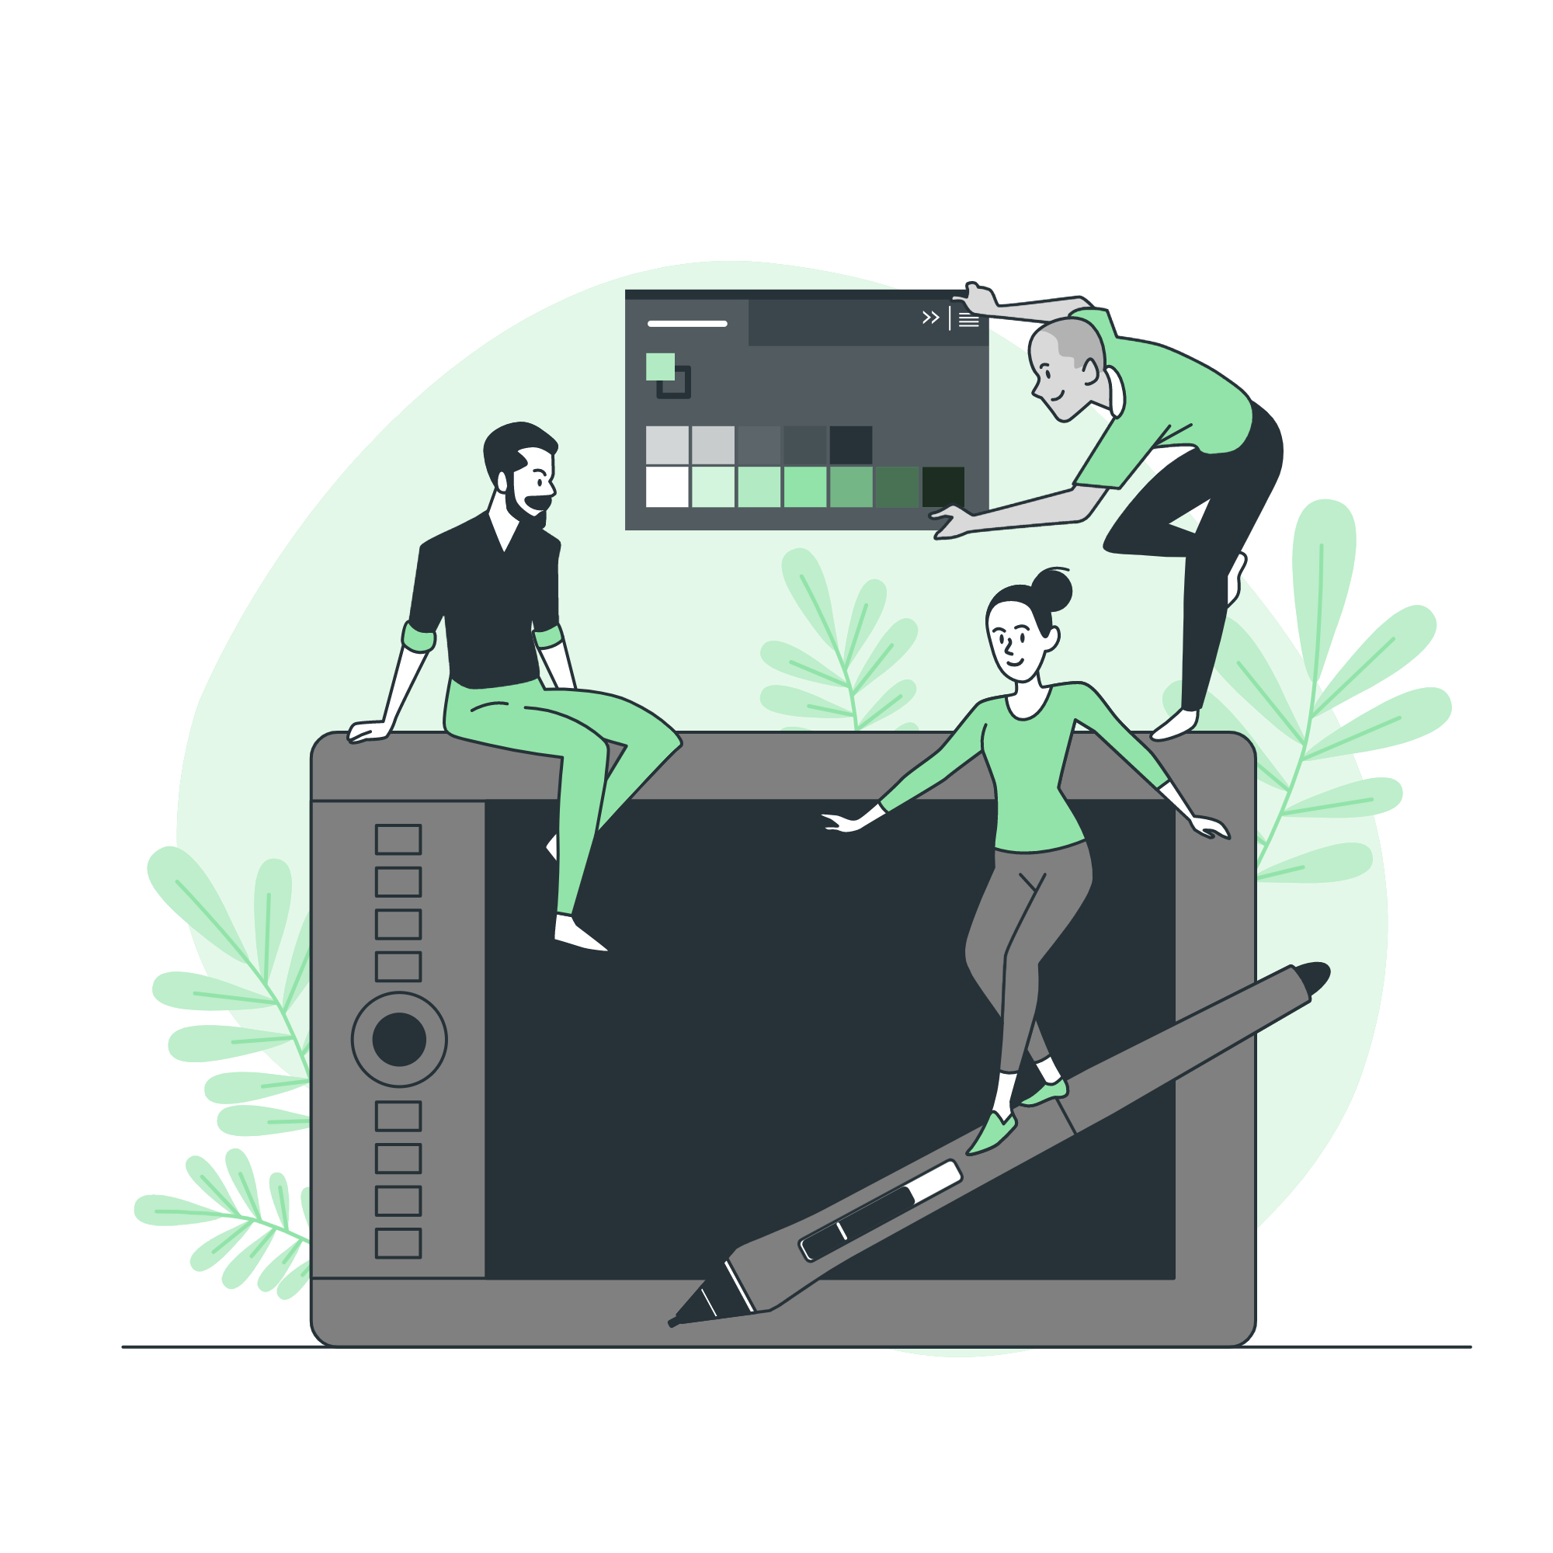

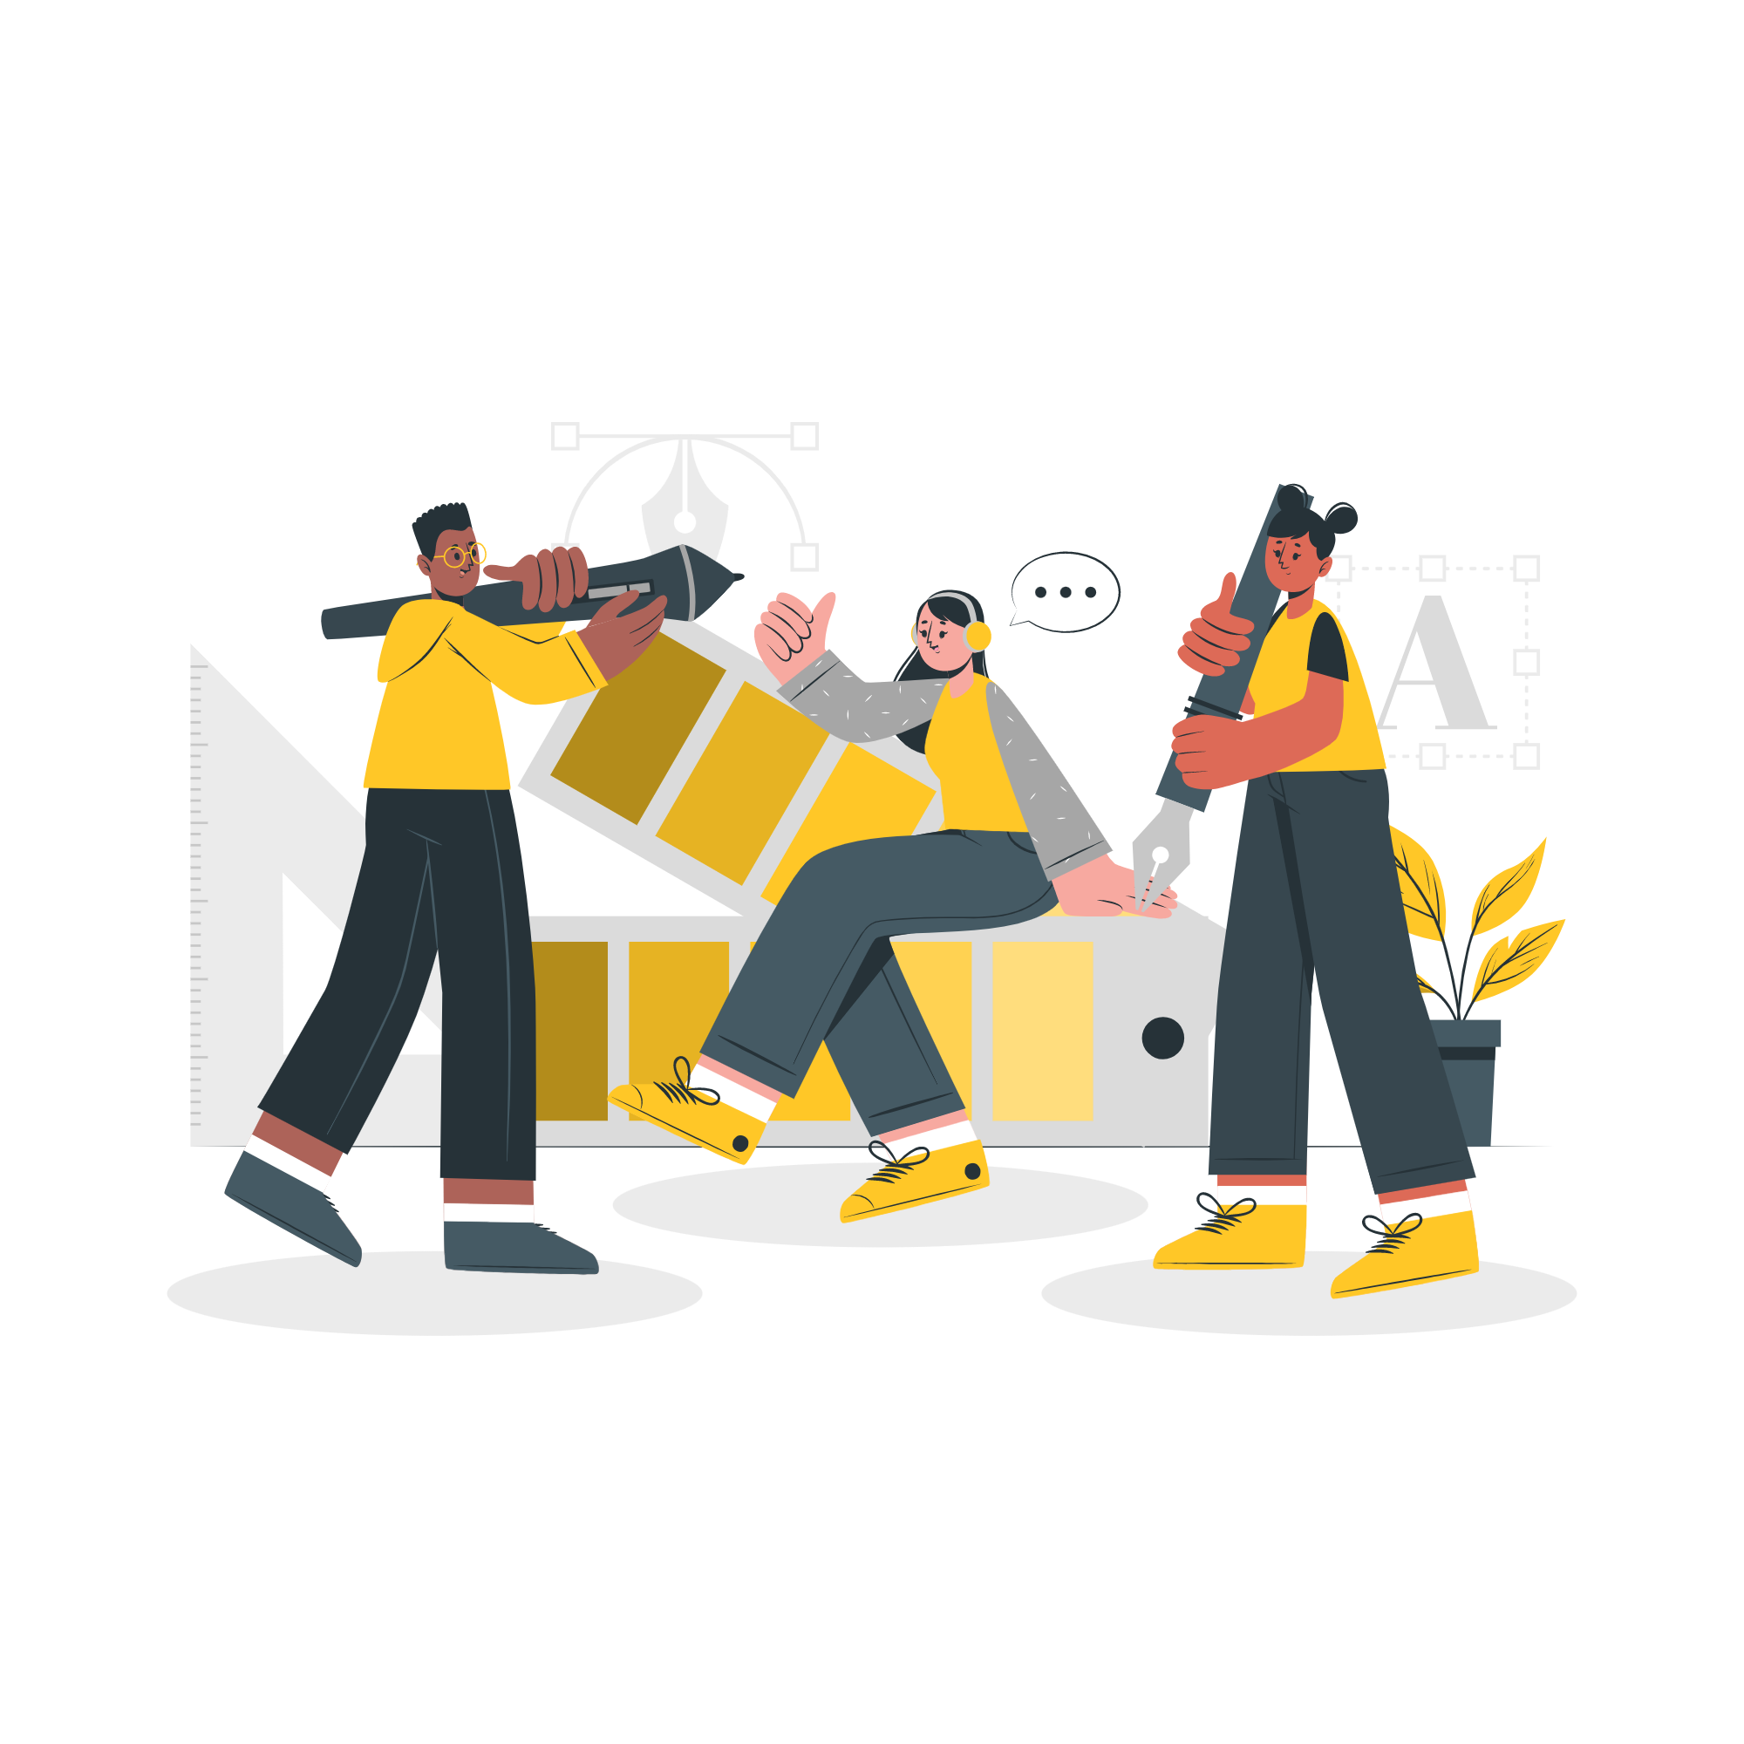

Storyset
Create your Story with our illustrated concepts. Choose the style you like the most, edit its colors, pick the background and layers you want to show and bring them to life with the animator panel! It will boost your presentation. Check out how it works.
Pana
Amico
Bro
Rafiki
Cuate

Slide 27
Use our editable graphic resources...
You can easily resize these resources without losing quality. To change the color, just ungroup the resource and click on the object you want to change. Then, click on the paint bucket and select the color you want. Group the resource again when you’re done. You can also look for more infographics on Slidesgo.

Slide 30
JANUARY
FEBRUARY
MARCH
APRIL
MAY
JUNE
PHASE 1
Task 1
Task 2
PHASE 2
Task 1
Task 2
JANUARY
FEBRUARY
MARCH
APRIL
PHASE 1
Task 1
Task 2

Slide 33
...and our sets of editable icons
You can resize these icons without losing quality.
You can change the stroke and fill color; just select the icon and click on the paint bucket/pen.
In Google Slides, you can also use Flaticon’s extension, allowing you to customize and add even more icons.

Slide 34
Educational Icons
Medical Icons

Slide 35
Business Icons
Teamwork Icons

Slide 36
Help & Support Icons
Avatar Icons

Slide 37
Creative Process Icons
Performing Arts Icons

Slide 38
Nature Icons

Slide 39
SEO & Marketing Icons

Slide 40


